Slide 1
P R E S E N T E D B Y
Your Name Here
D E V E L O P E D B Y
David Freeman Linda Kirby Nancy Barger

Slide 2
Your Name and Credentials
[insert name]
MBTI® Certified Practitioner
[insert additional credentials]
[insert your applications of type]
[insert your other relevant experience]
2

Slide 3
Objectives
At the end of this training you will be able to:
[insert objective]
[insert objective]
[insert objective]
And
Identify ways to use differences constructively
3

Slide 4
Achieving These Objectives
To achieve these objectives, we will be using the Myers-Briggs Type Indicator ® (MBTI®) instrument and looking at the ideas on which it is based
4

Slide 5
Today’s Agenda
Explain and verify MBTI® results
The MBTI instrument, meaning of “preferences”
MBTI definitions, with self-assessment
Individual results and verification
Team type table
Apply type information to our teamwork
Type activities
Team action plans
5

Slide 6
About the MBTI® Instrument
An indicator—not a test
Looks only at normal behaviour
Forced-choice questions
No right or wrong answers—no better or worse types.
All types have potential strengths and possible pitfalls or blind spots
Your results are confidential
6

Slide 7
Users of the MBTI® Instrument
Most Fortune 100 companies use it
The most widely used personality assessment in the world—more than 2 million people worldwide each year
Translated into two dozen+ languages
Used in 70+ different countries
7

Slide 8
Where the MBTI® Tool Is Used
USA
Canada
Mexico
South America
UK
Europe
Australia
New Zealand
China
India
Japan
Korea
Malaysia
Singapore
Middle East
Dubai
South Africa
Kenya
And more!
8

Slide 9
Carl G. Jung
Carl Gustav Jung (1875–1961), a Swiss psychiatrist, developed a theory of personality: Differences between people are not random. Instead they form patterns—types.
Psychological Types (published 1921, translated into English 1923)
9

Slide 10
Katharine C. Briggs
Katharine C. Briggs (1875–1968), an American, read Jung’s Psychological Types in 1923.
She spent the next 20 years studying, developing, and applying Jung’s theory.
10

Slide 11
Isabel Briggs Myers
Isabel Briggs Myers (1897–1980) developed Jung’s theory in partnership with Briggs.
Beginning in 1943, she developed questions that became the Myers-Briggs Type Indicator® instrument.
11

Slide 12
Jung’s Personality Theory
Every person carries out two kinds of mental processes:
We take in information
Then we make decisions about the information
Everyone has preferred ways of using these mental processes
12

Slide 13
Jung’s Personality Theory (cont.)
Jung observed that we all live in two worlds:
The outer world of things, people, and events and
The inner world of our own thoughts, feelings, and reflections
Each person has a preference for either the outer world or the inner world
13

Slide 14
Jung’s Personality Theory (cont.)
Jung believed that preferences are innate—“inborn predispositions”
He also recognised that they are shaped by environmental influences, such as family, culture, and education
Nature
MBTI® instrument
Nurture
Environment
vs.
14

Slide 15
“Handedness” Activity
To illustrate this—let’s do an activity.
Turn to p. 4 in your Introduction to Myers-Briggs® Type booklet and sign your name in the first box
Now sign your name again in the second box—using the other hand
Call out some words that describe the experience of writing the first signature
Now, some words to describe writing the second signature
15

Slide 16
“Handedness” Activity (cont.)
Where do we get our preference for using one hand over the other?
How does the environment influence our preference for using one hand over the other?
Note: We all can and do use both hands; for
writing, one is natural, comfortable, automatic
16

Slide 17
The MBTI® Dichotomies
The MBTI® instrument indicates preferences on four pairs of opposites, called dichotomies:
Extraversion E or I Introversion
Sensing S or N Intuition
Thinking T or F Feeling
Judging J or P Perceiving
17

Slide 18
MBTI® Theory
Four pairs of opposites—like our right and left hands. We all use both sides of each pair, but one is our natural preference.
The MBTI® instrument is designed to indicate those inborn preferences.
The MBTI instrument is not designed to measure skills or effects of environment.
18

Slide 19
Extraversion (E) or Introversion (I)
Where we focus our attention and get energy
Source: Introduction to Myers-Briggs® Type (7th ed.), I. B. Myers, p. 5.
19

Slide 20
E–I Differences
People who prefer Extraversion:
Direct their energy and attention outward
Focus on the outer world of people and activity
People who prefer Introversion:
Direct their energy and attention inward
Focus on their inner world of ideas and experiences
We all use both preferences, but usually
not with equal comfort.
Source: Introduction to Myers-Briggs® Type (7th ed.), I. B. Myers, p. 5.
20

Slide 21
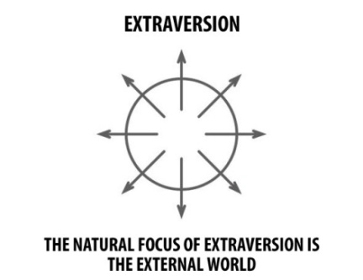
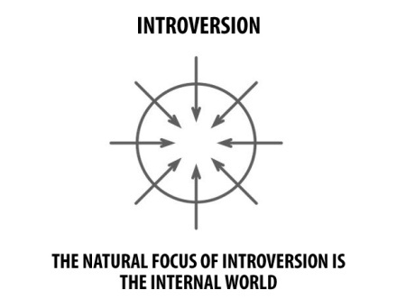
E–I Illustration
Source: Introduction to Type® and Change, N. J. Barger & L. K. Kirby, p. 4.
21

Slide 22
Where People Focus Their Attention
People who prefer Extraversion (E)
Are energised by interacting with others
Are sociable and expressive
Prefer to communicate face-to-face
Work out ideas by talking them through
People who prefer Introversion (I)
Are energised by opportunity to reflect
Are private and contained
Prefer to communicate by writing
Work out ideas by thinking them through
Source: Introduction to Myers-Briggs® Type (7th ed.), I. B. Myers, p. 5.
22

Slide 23
Where People Focus Their Attention (cont.)
People who prefer Extraversion (E)
Have broad interests in many things
Learn best through doing or discussing
Readily take initiative in work and relationships
People who prefer Introversion (I)
Focus in depth on their interests
Learn best by reflection, mental “practice”
Take initiative when the situation or issue is very important to them
Source: Introduction to Myers-Briggs® Type (7th ed.), I. B. Myers, p. 5.
23

Slide 24
Key Words Associated with E–I
Extraversion
Action
Outward
People
Interaction
Many
Expressive
Do-Think-Do
Introversion
Reflection
Inward
Privacy
Concentration
Few
Quiet
Think-Do-Think
24

Slide 25
We Have a Preference
We all do Extraverted and Introverted things. But we usually do not do them with equal comfort. Most of us have a preference for one or the other.
25

Slide 26
E–I Self-Assessment
Given the choice, which do you prefer: Extraversion or Introversion?
☑ your self-assessment
26

Slide 27
Sensing (S) or Intuition (N)
The way we take in information and the kind of information we like and trust
Source: Introduction to Myers-Briggs® Type (7th ed.), I. B. Myers, p. 5.
27

Slide 28
S–N Differences
People who prefer Sensing:
Focus on present realities, verifiable facts, and experience
People who prefer Intuition:
Focus on future possibilities, the big picture, and insights
We all use both ways of perceiving, but we typically prefer and trust one of them more.
Source: Introduction to Myers-Briggs® Type (7th ed.), I. B. Myers, p. 5.
28

Slide 29
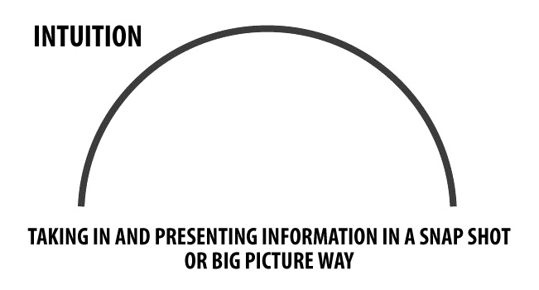
S–N Illustration
Source: Introduction to Type® and Change, N. J. Barger & L. K. Kirby, p. 4.
29

Slide 30
How People Take In Information
People who prefer Sensing (S)
Focus on what is real and actual
Observe and remember specifics
Are factual, concrete, and sequential
People who prefer Intuition (N)
Focus on patterns and meanings
Remember specifics when they relate to a pattern
Are abstract and imaginative
Source: Introduction to Myers-Briggs® Type (7th ed.), I. B. Myers, p. 5.
30

Slide 31
How People Take In Information (cont.)
People who prefer Sensing (S)
Build carefully and thoroughly toward conclusions
Understand ideas and theories through practical applications
Are specific and literal
Trust experience
People who prefer Intuition (N)
Move quickly to conclusions, follow hunches
Generate ideas and theories; application is secondary
Use metaphors and analogies
Trust insight
Source: Introduction to Myers-Briggs® Type (7th ed.), I. B. Myers, p. 5.
31

Slide 32
Key Words Associated with S–N
Sensing
Facts
Realistic
Specific
Present
Keep
Practical
What is
Intuition
Ideas
Imaginative
General
Future
Change
Theoretical
What could be
32

Slide 33
We Have a Preference
We all use Sensing and Intuition when making our observations about the world. But we usually do not use them with equal trust. Most of us have a preference for one or the other.
33

Slide 34
S–N Self-Assessment
Given the choice, which do you prefer: Sensing or Intuition?
☑ your self-assessment
34

Slide 35
Thinking (T) or Feeling (F)
The way we make decisions
Source: Introduction to Myers-Briggs® Type (7th ed.), I. B. Myers, p. 6.
35

Slide 36
T–F Differences
People who prefer Thinking:
Make their decisions based on impersonal, objective logic
People who prefer Feeling:
Make their decisions based on personal priorities and relationships
Both processes are rational and we use both,
but usually not with equal ease.
Source: Introduction to Myers-Briggs® Type (7th ed.), I. B. Myers, p. 6.
36

Slide 37
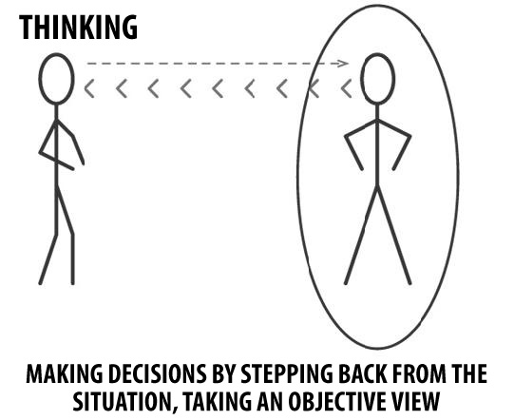
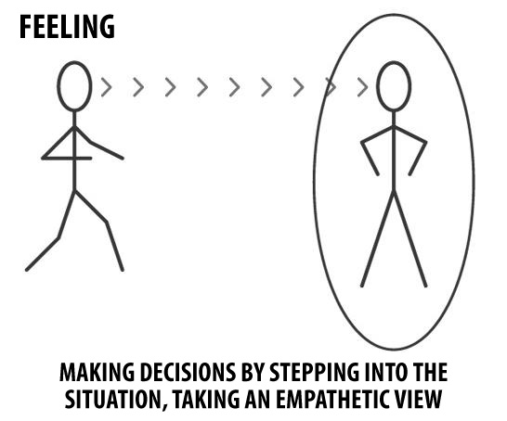
T–F Illustration
Source: Introduction to Type® and Change, N. J. Barger & L. K. Kirby, p. 5.
37

Slide 38
How People Make Decisions
People who prefer Thinking (T)
Step back to get an objective view
Analyse
Use cause-and-effect reasoning
Solve problems with logic
People who prefer Feeling (F)
Step in to identify with those involved
Empathise
Are guided by personal and group values
Assess impacts of decisions on people
Source: Introduction to Myers-Briggs® Type (7th ed.), I. B. Myers, p. 6.
38

Slide 39
How People Make Decisions (cont.)
People who prefer Thinking (T)
Strive for an objective standard of truth
Are “reasonable”
Can be “tough-minded”
Are fair—want everyone to be treated equally
People who prefer Feeling (F)
Strive for harmony and positive interactions
Are compassionate
May appear “tenderhearted”
Are fair—want everyone to be treated as an individual
Source: Introduction to Myers-Briggs® Type (7th ed.), I. B. Myers, p. 6.
39

Slide 40
Key Words Associated with T–F
Thinking
Head
Detached
Things
Objective
Critique
Analyse
Firm but fair
Feeling
Heart
Personal
People
Subjective
Praise
Understand
Merciful
40

Slide 41
We Have a Preference
We all use both Thinking and Feeling
when making decisions. But we usually do not use them with equal ease. Most of us have a preference for one or the other.
41

Slide 42
T–F Self-Assessment
Given the choice, which do you prefer: Thinking or Feeling?
☑ your self-assessment
42

Slide 43
Judging (J) or Perceiving (P)
Our attitude toward the external world and how we orient ourselves to it
Source: Introduction to Myers-Briggs® Type (7th ed.), I. B. Myers, p. 6.
.
43

Slide 44
J–P Differences
People who prefer Judging:
Want the external world to be organised and orderly
Look at the world and see decisions that need to be made
People who prefer Perceiving:
Seek to experience the world, not organise it
Look at the world and see options that need to be explored
We all use both attitudes, but usually not with equal comfort.
Source: Introduction to Myers-Briggs® Type (7th ed.), I. B. Myers, p. 6.
44

Slide 45
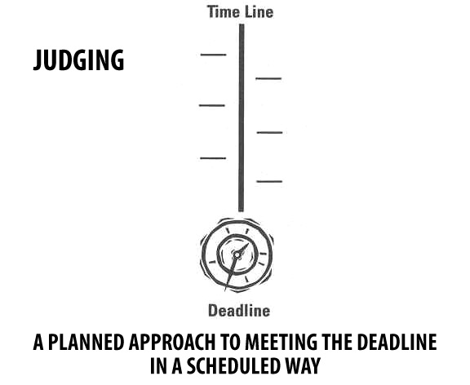
J–P Illustration
Source: Introduction to Type® and Change, N. J. Barger & L. K. Kirby, p. 5.
45

Slide 46
How People Approach Life
People who prefer Judging (J)
Organised
Systematic
Methodical
Make short- and long-term plans, and then follow them
People who prefer Perceiving (P)
Adaptable and curious
Casual
Open-ended
Adjust flexibly to new information and changes
Source: Introduction to Myers-Briggs® Type (7th ed.), I. B. Myers, p. 6.
46

Slide 47
How People Approach Life (cont.)
People who prefer Judging (J)
Like to have things decided
Resist reopening decisions
Try to avoid last-minute stresses
People who prefer Perceiving (P)
Like to explore options
Resist cutting off options, making decisions too soon
Feel energised by last-minute pressures
Source: Introduction to Myers-Briggs® Type (7th ed.), I. B. Myers, p. 6.
47

Slide 48
Key Words Associated with J–P
Judging
Organised
Decision
Control
Now
Closure
Deliberate
Plan
Perceiving
Flexible
Information
Experience
Later
Options
Spontaneous
Wait
48

Slide 49
We Have a Preference
We all use Judging and Perceiving as part of our lifestyle. But we usually do not use them with equal comfort. Most of us have a preference for one or the other.
49

Slide 50
J–P Self-Assessment
Given the choice, which do you prefer: Judging or Perceiving?
☑ your self-assessment
50

Slide 51
Personality Type
When combined, your preferences indicate your personality type.
51

Slide 52
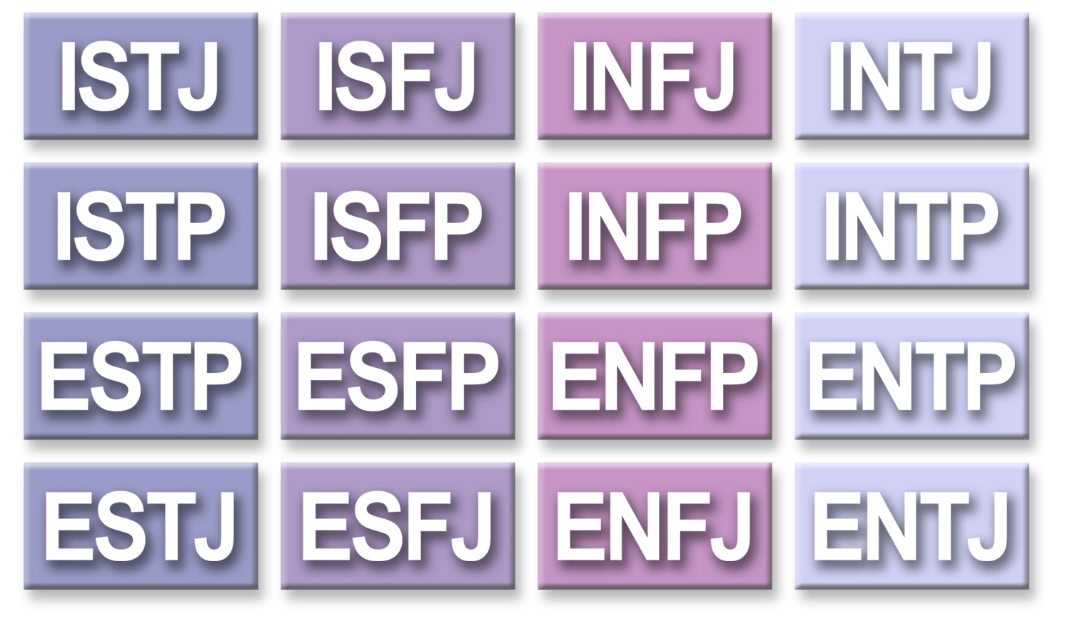
16 Personality Types
52

Slide 53
Self-Estimate
As a result of learning about the eight preferences and deciding which four you prefer, you have completed a self-estimate of your type.
Write your self-estimate in your Introduction to Myers-Briggs® Type booklet, p. 7.
Now let’s see what your reported type is (based on how you responded to the items).
Write your results in your Introduction to Myers-Briggs® Type booklet, p. 7.
53

Slide 54
MBTI® Step I™ Profile Report
Page 2:
Gives four-letter reported type based on computer scoring of your responses to the instrument items
Defines preferences briefly
Lists characteristics frequently associated with the reported four-letter type
54

Slide 55
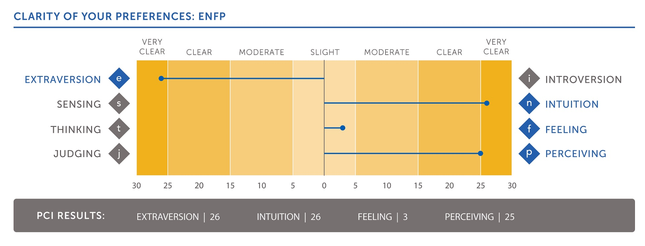
MBTI® Step I™ Profile Report (cont.)
Page 3:
PCC
PCI
55

Slide 56
Type Results
pci = preference clarity index
a number ranging from 1 to 30, assigned by computer scoring, that indicates how consistently you chose one side of a dichotomy
pcc = preference clarity category
a label describing how consistently you chose one side of a dichotomy— slight, moderate, clear, or very clear
56

Slide 57
Meaning of Results
The MBTI® instrument does not measure how much or how well you do something
It is intended to indicate your innate preferences
The number or category reported with the letter = the clarity with which you indicated your preference
57

Slide 58
Reported and Self-Estimated Type
If these are the same:
Read the one-page description in your Introduction to Myers-Briggs® Type booklet and decide: Does it fit your understanding of yourself?
If they are different:
Read descriptions for both your self-estimated and reported types in your Introduction to Myers-Briggs® Type booklet. Decide which one fits best.
58

Slide 59
“Has My Type Changed?”
Why might you get different results?
You answered the items differently!
Different mind-set
Familiarity with MBTI® questions and definitions may skew responses
Remember: MBTI results report how you responded to the items—you decide your “best-fit” type
59

Slide 60
Levels of Confidence
“Best-fit” type
Reported type
Self-estimated type
True type—innate predispositions
60

Slide 61
Our Type Table
When you are clear about your “best-fit” type:
Sign your name in your best-fit type space
Then we’ll look at our team’s type distribution and how that may affect our team dynamics
61

Slide 62
16-Room House
62

